Slide 1
Chapter 3 Thermodynamics of Biological Systems (Substitute Chapter 3 from Matthews et al. is posted on eLearning)

Slide 2
Outline
1st & 2nd Laws of Thermodynamics
Enthalpy & entropy
Gibbs free energy equations for reactions
Coupled reactions
ATP, how it works as the energy carrier
of the cell

Slide 3
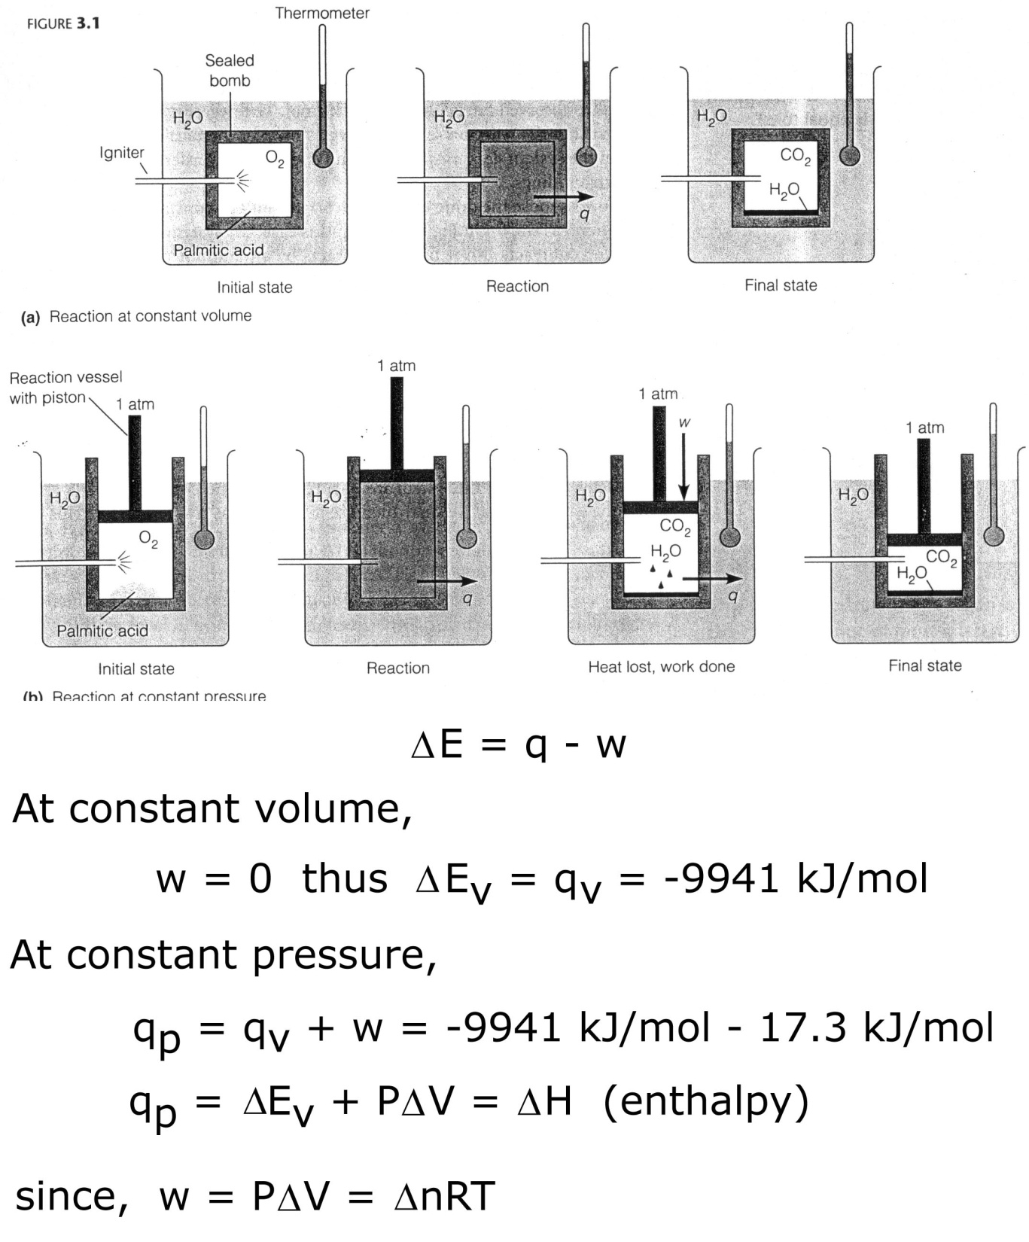
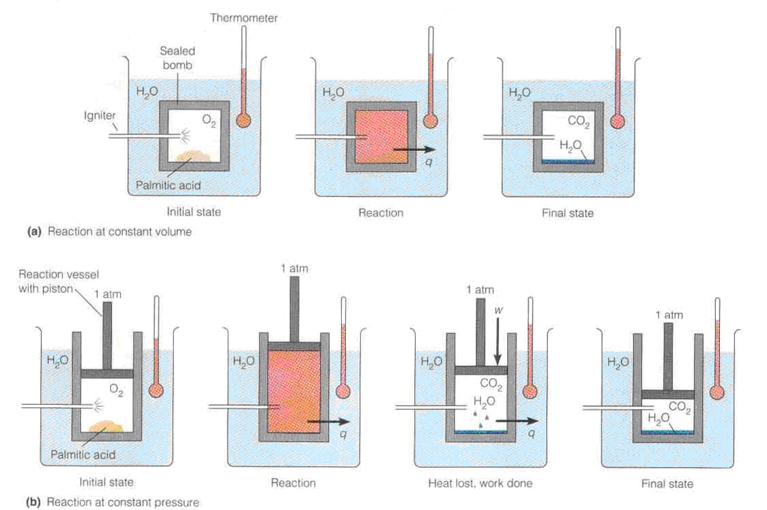
Fig. 3.1 Exchange of heat & work in
(a) constant volume and (b) constant pressure reactions
Notes:
-w, surroundings do work on the system; +q, surrounding give heat to the system
+w, system does work on the surroundings; -q, system gives up heat to the surroundings

Slide 4
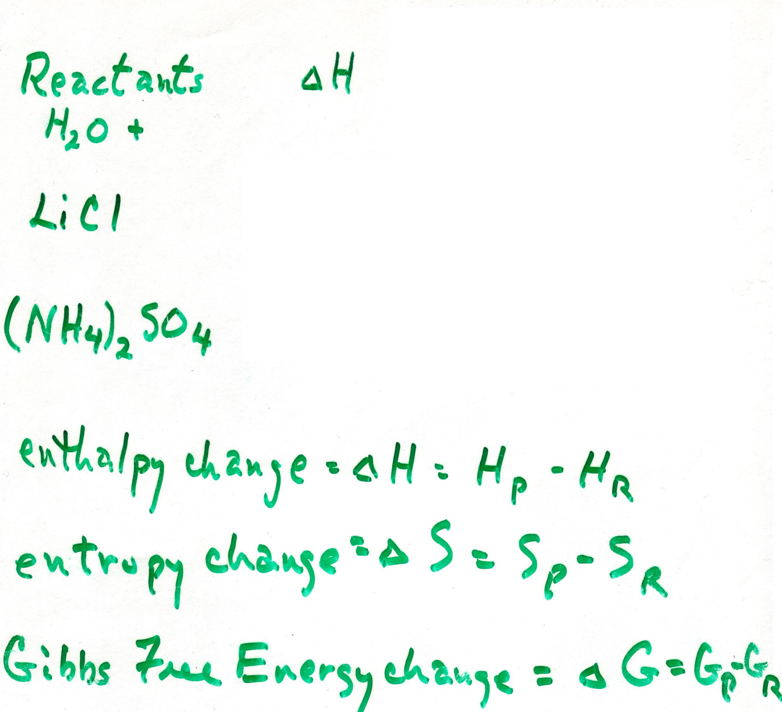
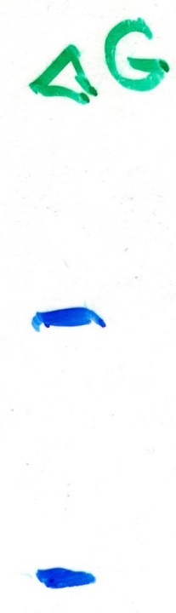
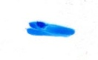
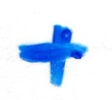
Example Reactions Involving Weak Interactions

Slide 5
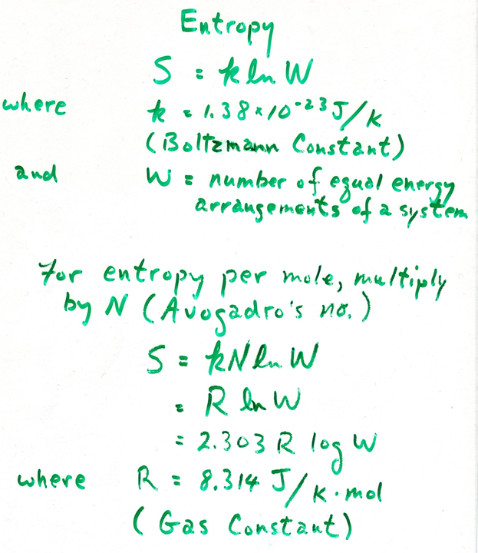

Slide 6
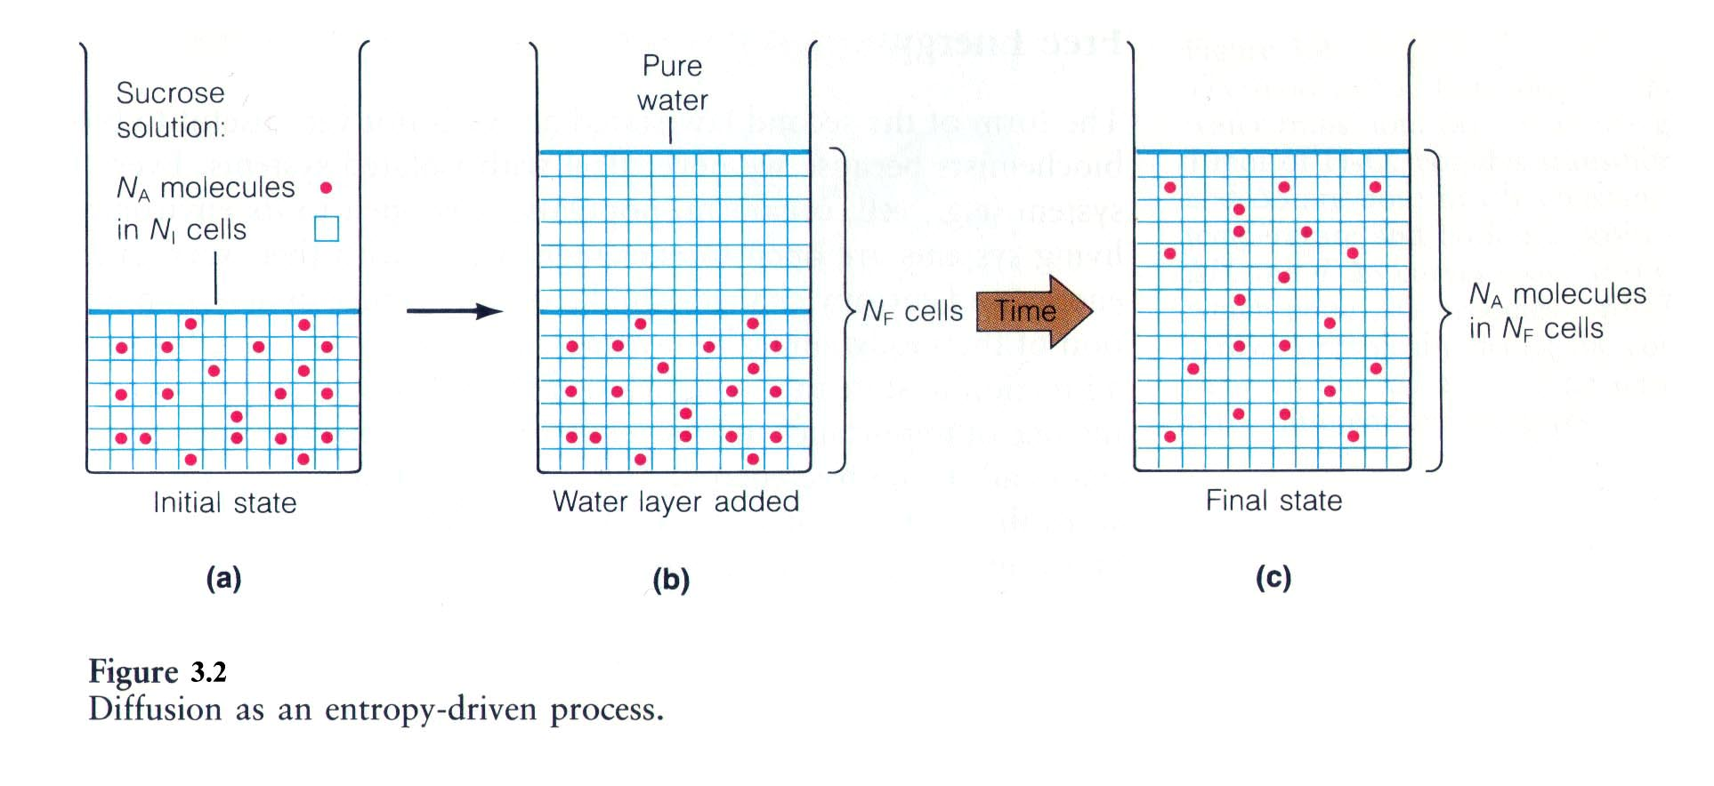

Slide 7
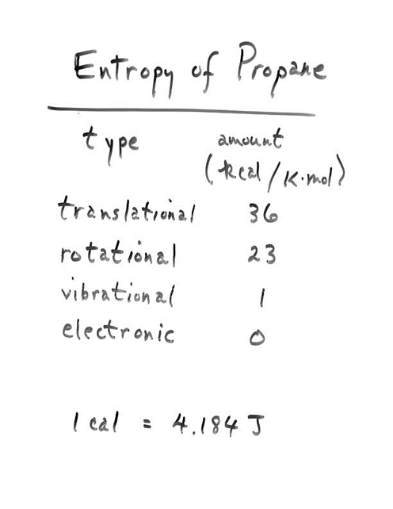

Slide 8
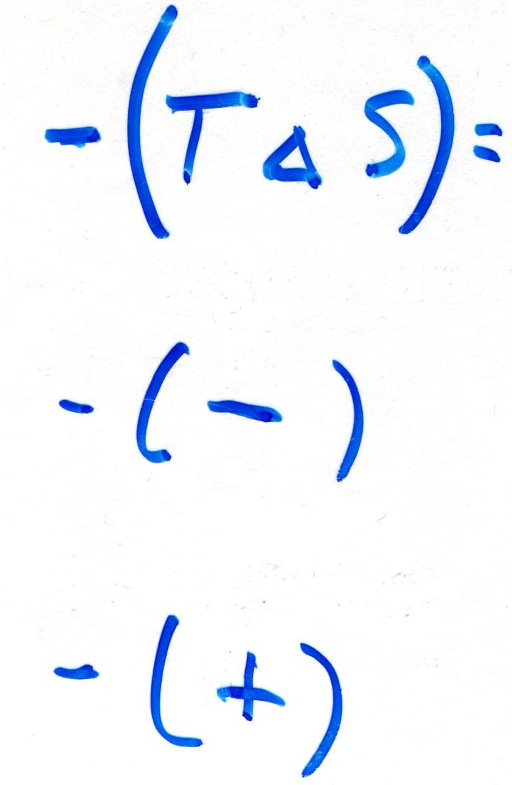
Example Reactions Involving Weak Interactions

Slide 9
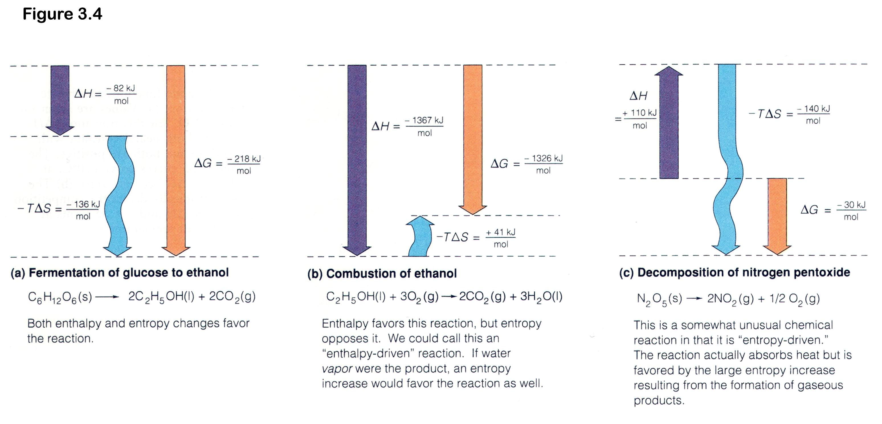
Reactions are driven by enthalpy and entropy, alone or together

Slide 10
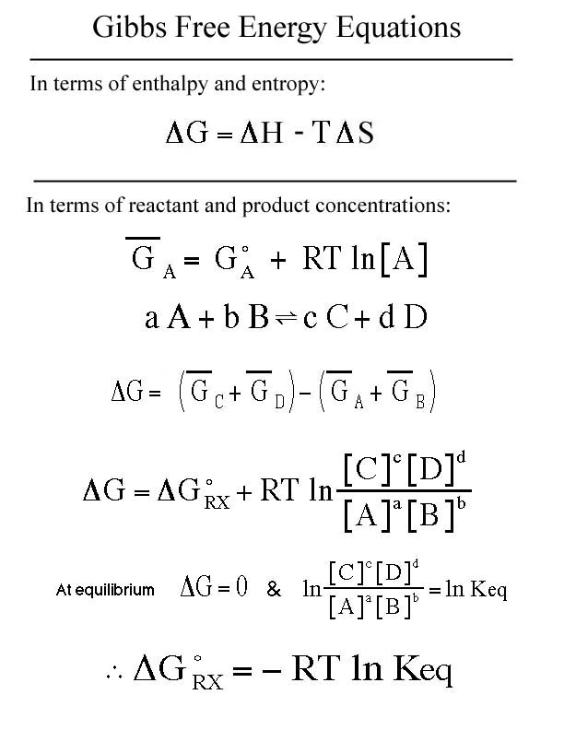

Slide 11
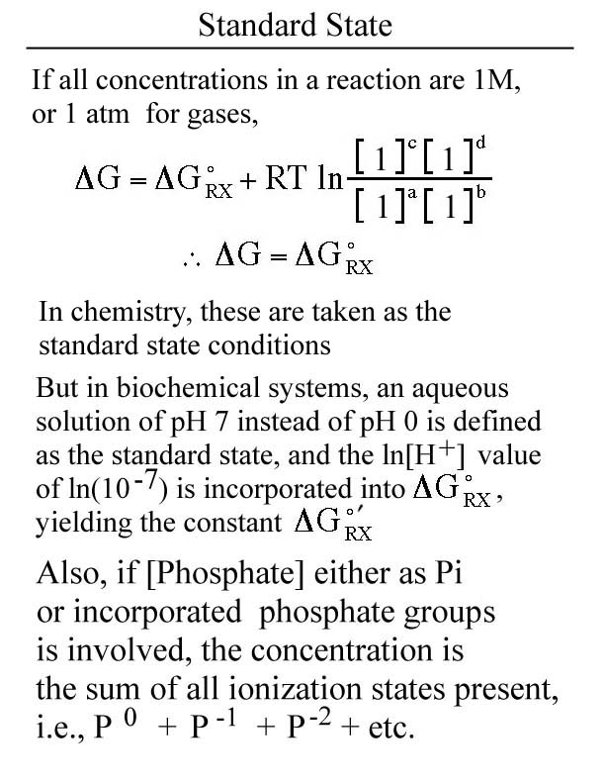

Slide 12
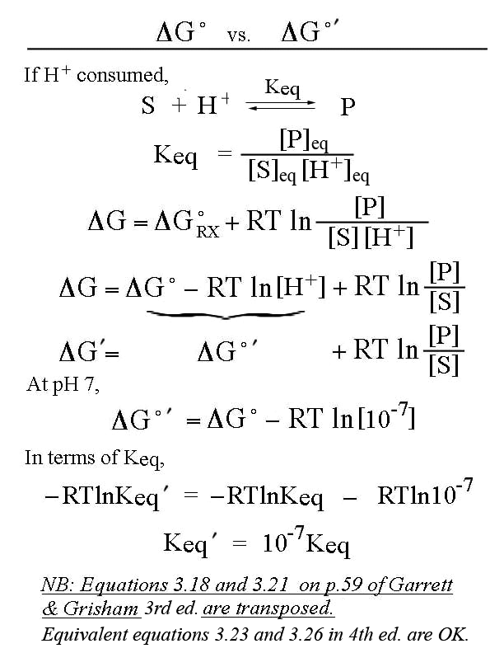
← These are equilibration
concentrations
←These are variable
concentrations

Slide 13
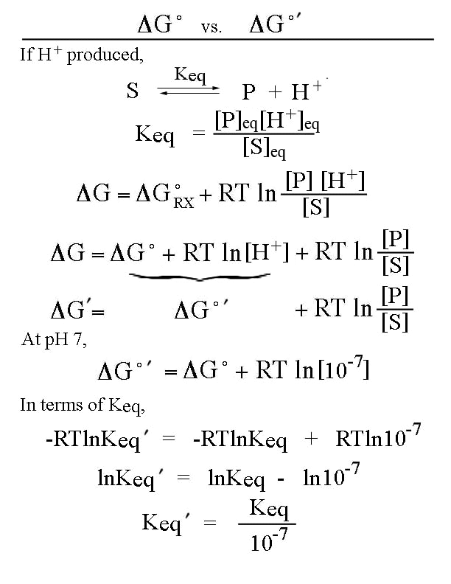

Slide 14
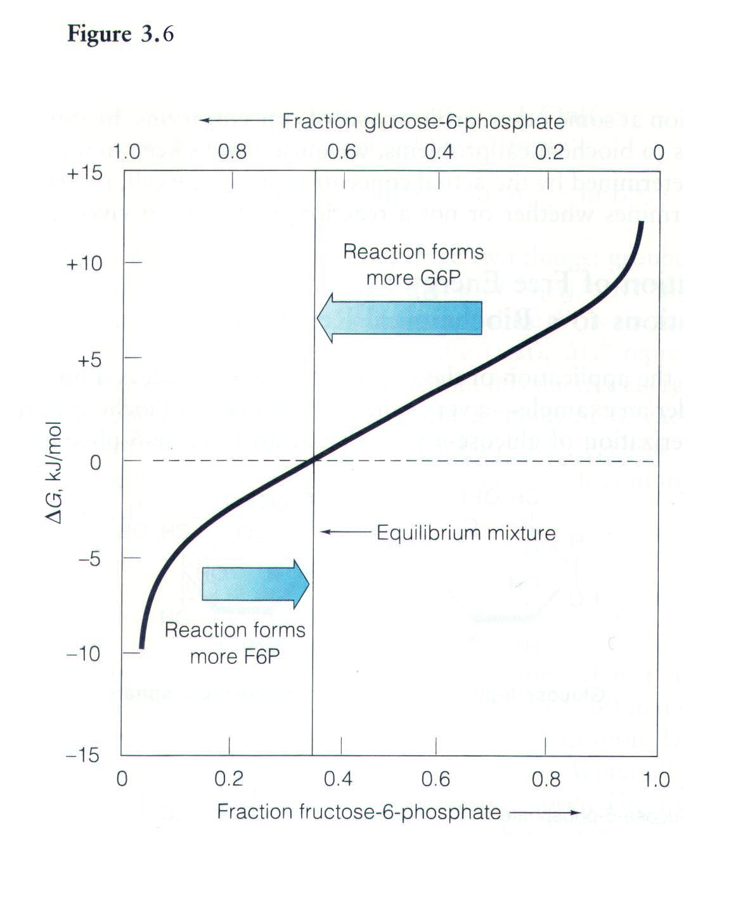
Fig. 3.6 Free energy change as a function of reaction mixture composition. The black curve shows ΔG for the conversion of 1 mole glucose-6-phosphate to fructose-6-phosphate as a function of the fraction of either component.

Slide 15
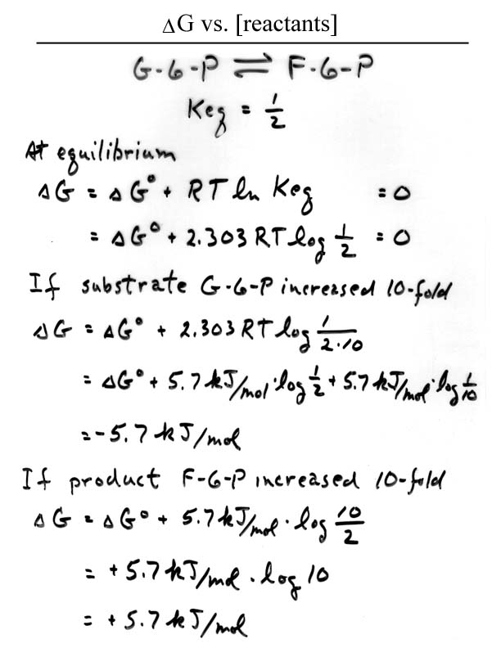

Slide 16
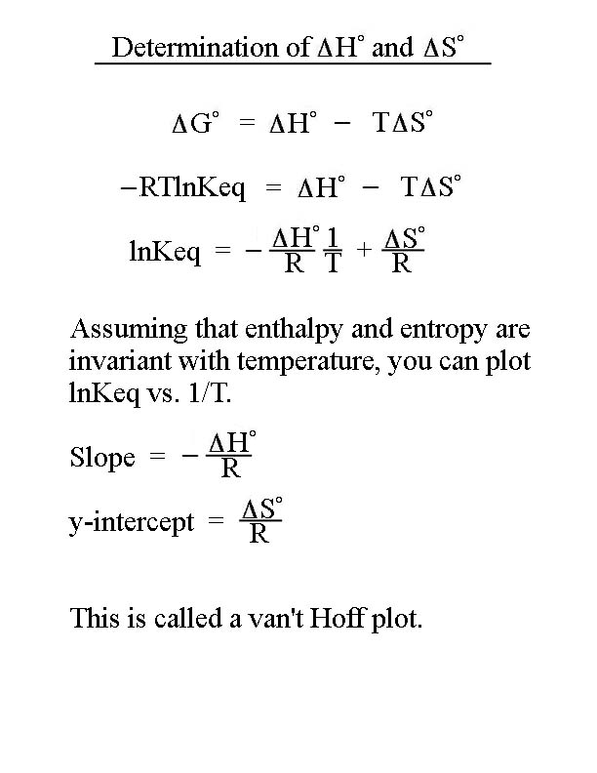

Slide 17
Coupled Reactions
Bioreactions with unfavorable ΔGº′ are often driven in the forward direction by coupling the reaction to hydrolysis of a high-energy phosphate compound.
The overall ΔGº′ for a coupled reaction is the sum of the two ΔGº′ values for the individual reactions.
ATP is the most commonly used high-energy compound. It can be considered the energy currency of the cell.

Slide 18
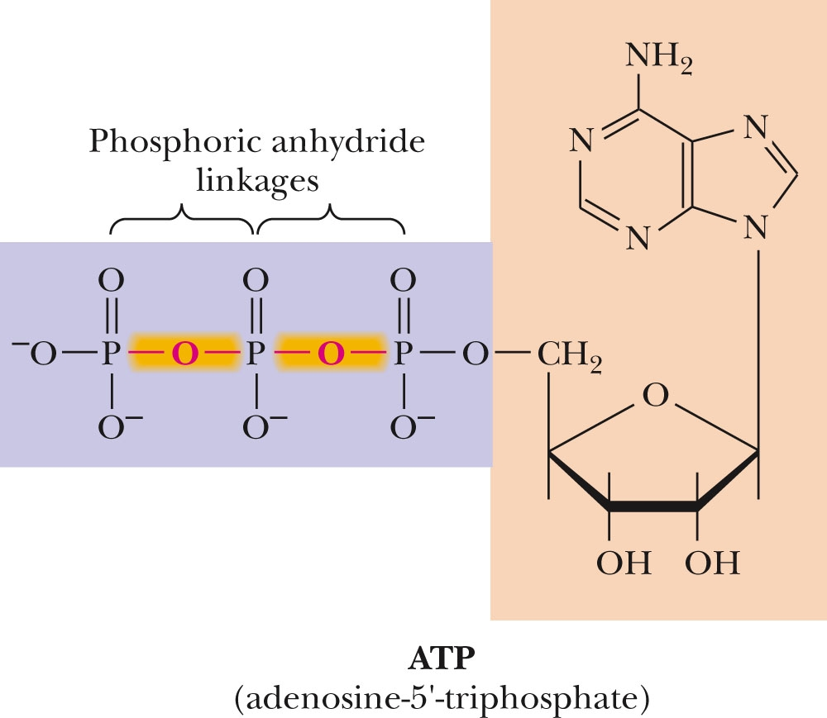
ATP Contains Two Pyrophosphate Linkages
(from Garrett & Grisham,
page 63)
Figure 3.4
ATP contains two pyrophosphate linkages. The hydrolysis of phosphoric acid anhydrides is highly favorable.

Slide 19
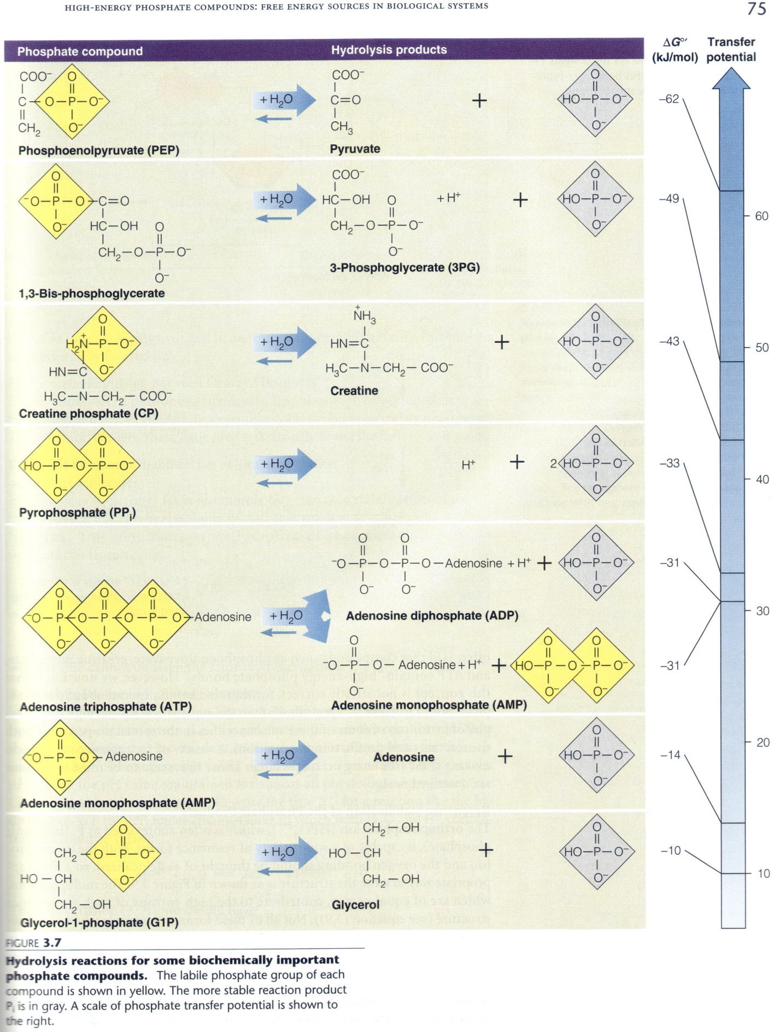
Fig. 3.7 Hydrolysis reactions for some biologically important ‘high-energy’ phosphate compounds. Labile phosphate groups highlighted in yellow; Pi products in blue. ΔG°′ values for the reactions (aka. transfer potentials for the labile phosphates) are shown to the right.

Slide 20
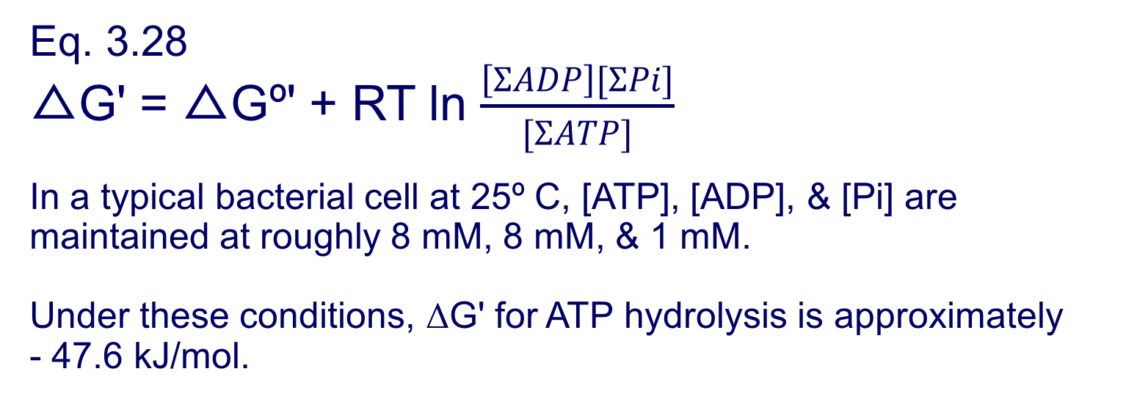
Concentration Affects the Free Energy of Hydrolysis of ATP
(from Garrett & Grisham, page 68)

Slide 21
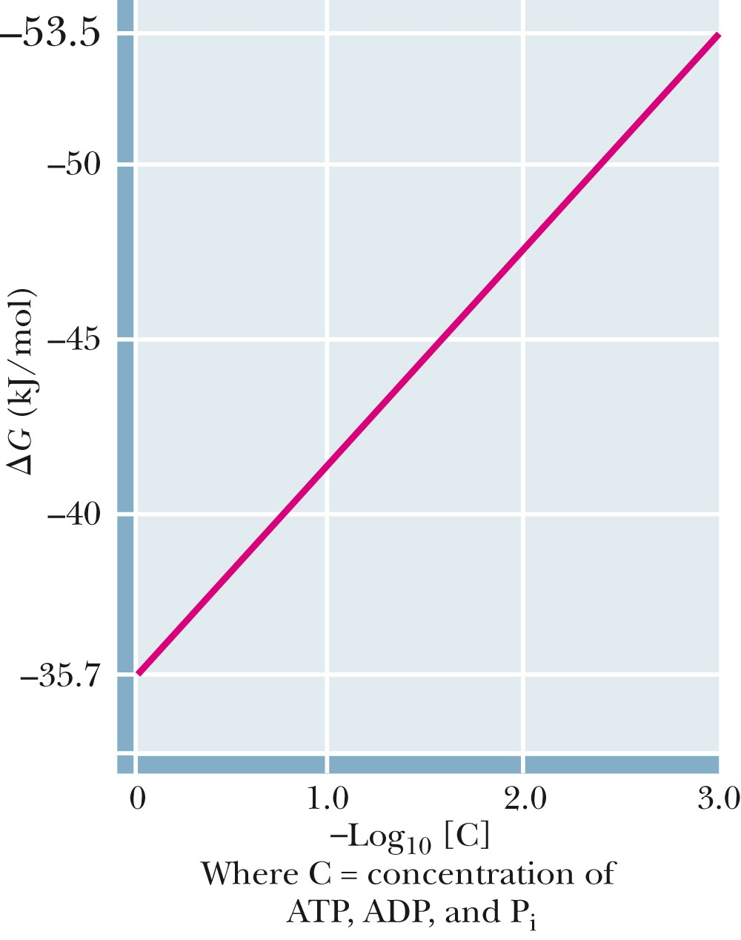
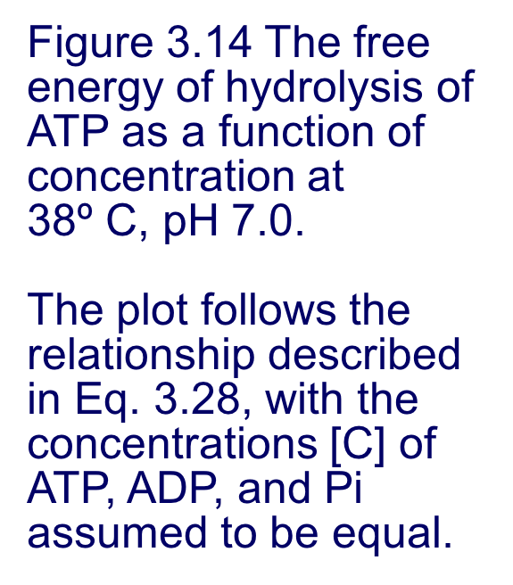
Concentration Affects the Free Energy of Hydrolysis of ATP
(from Garrett & Grisham, page 69)

Slide 22
Phosphoric Acid Anhydrides
Why ATP does what it does!
ADP and ATP are examples of phosphoric acid anhydrides
Large negative free energy change on hydrolysis is due to:
electrostatic repulsion
stabilization of products by ionization and resonance
entropy factors

Slide 23
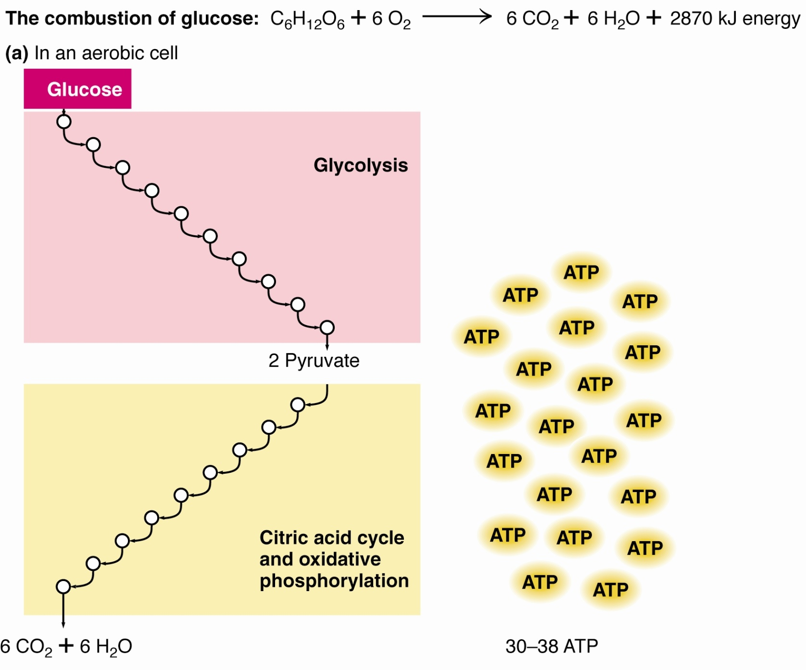
1.4 – Properties of Biomolecules Reflect Their Fitness to the Living Condition
Cells release the energy of glucose in a stepwise fashion, forming ATP

